Slide 1
Discrete-Time Signals and Systems
Lecture 26

Slide 2
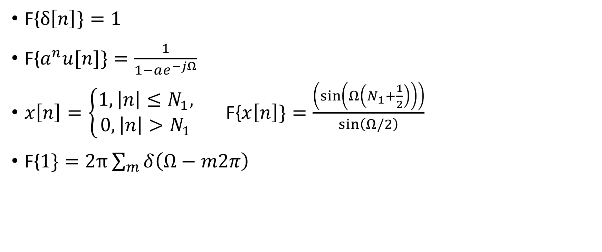
Examples of FT pairs
F{$δ\left[n\right]\}=1$
F{$a^{n}u[n]\}=\frac{1}{1−ae^{−jΩ}}$
$x\left[n\right]=\left\{\begin{aligned}1, \left|n\right|≤N_{1}, \\ 0, \left|n\right|>N_{1}\end{aligned}\right.$ F{$x\left[n\right]\}=\frac{\left(\sin\left(Ω\left(N_{1}+\frac{1}{2}\right)\right)\right)}{\sin\left(Ω/2\right)}$
$\text{F}\text{\{}1\}=2π\sum_{m}{δ\left(Ω−m2π\right) }$

Slide 3
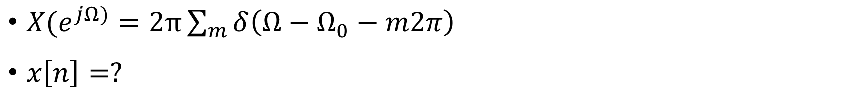
Examples of FT pairs
$X(e^{jΩ)}=2π\sum_{m}{δ\left(Ω−Ω_{0}−m2π\right) }$
$x\left[n\right]=?$

Slide 4
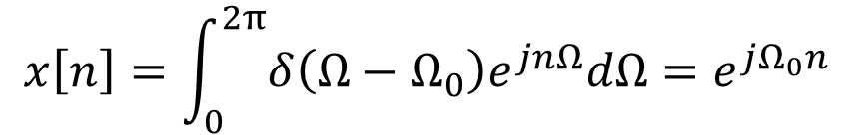
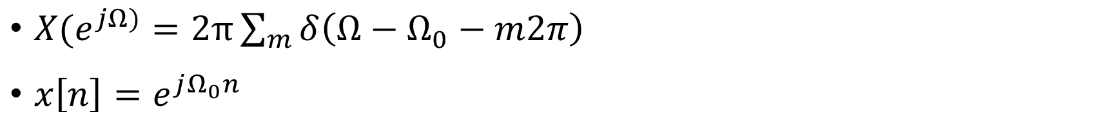
Examples of FT pairs
$X(e^{jΩ)}=2π\sum_{m}{δ\left(Ω−Ω_{0}−m2π\right) }$
$x\left[n\right]=e^{jΩ_{0}n}$
$$x\left[n\right]=\int_{0}^{2π}{δ\left(Ω−Ω_{0}\right)e^{jnΩ}dΩ}=e^{jΩ_{0}n}$$

Slide 5
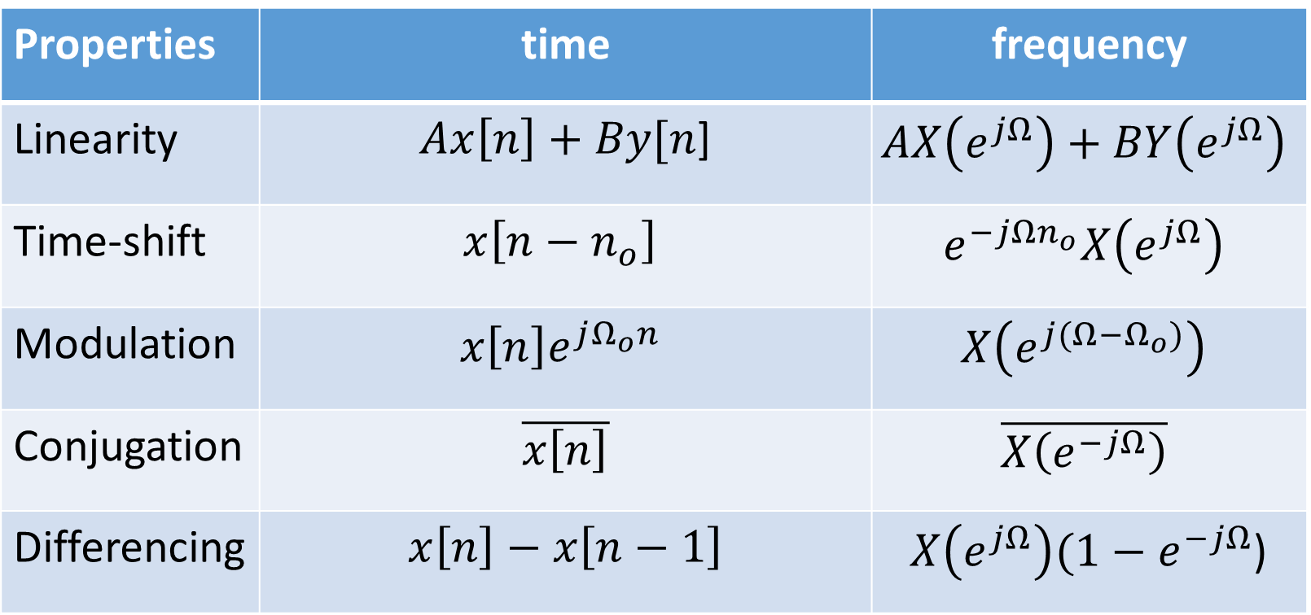
Properties of DTFT
Properties | time | frequency
Linearity | $Ax\left[n\right]+By[n$] | $$AX\left(e^{jΩ}\right)+BY\left(e^{jΩ}\right)$$
Time-shift | $$x\left[n−n_{o}\right]$$ | $$e^{−jΩn_{o}}X\left(e^{jΩ}\right)$$
Modulation | $$x\left[n\right]e^{jΩ_{o}n}$$ | $$X\left(e^{j(Ω−Ω_{o})}\right)$$
Conjugation | $$\overline{x\left[n\right]}$$ | $$\overline{X\left(e^{−jΩ}\right)}$$
Differencing | $$x\left[n\right]−x\left[n−1\right]$$ | $X\left(e^{jΩ}\right)(1−e^{−jΩ}$)

Slide 6

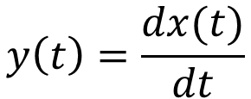
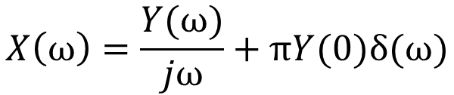
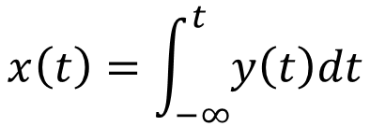
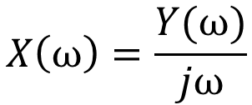
Caution in Differencing/Differentiation
$$y\left(t\right)=\frac{dx(t)}{dt}$$
$$x\left(t\right)=\int_{−∞}^{t}{y\left(t\right)dt}$$
$$X\left(ω\right)=\frac{Y(ω)}{jω}+πY(0)δ(ω)$$
$$Y\left(ω\right)=jωX(ω)$$
$$X\left(ω\right)=\frac{Y(ω)}{jω}$$

Slide 7


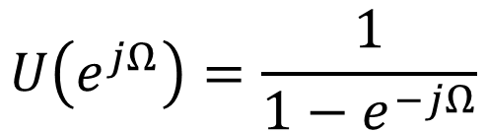
Caution in Differencing/Differentiation
$$u\left[n\right]−u[n−1]=δ[n]$$
$$U\left(e^{jΩ}\right)\left(1−e^{−jΩ}\right)=1$$
$$U\left(e^{jΩ}\right)=\frac{1}{1−e^{−jΩ}}$$

Slide 8
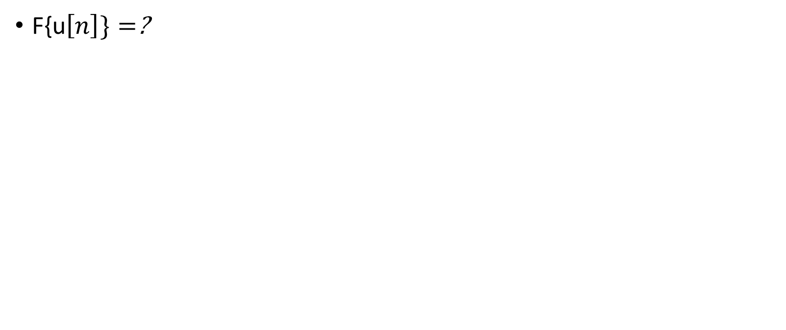
Examples of FT pairs
F{u$\left[n\right]\}=$?

Slide 9
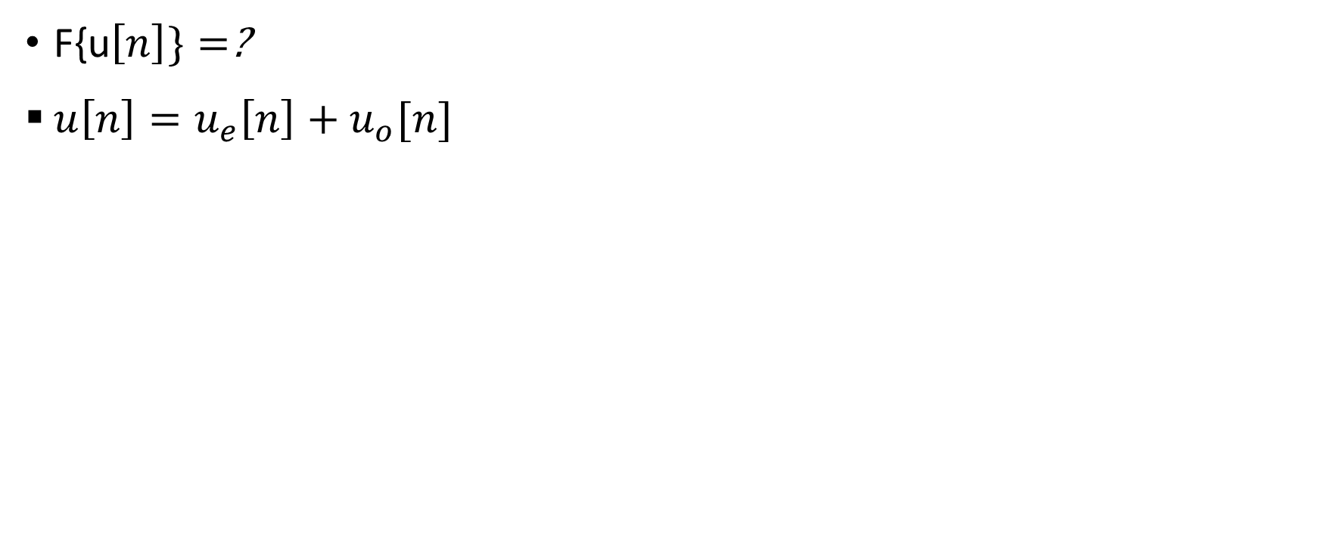
Example
F{u$\left[n\right]\}=$?
$u\left[n\right]=u_{e}\left[n\right]+u_{o}[n]$

Slide 10
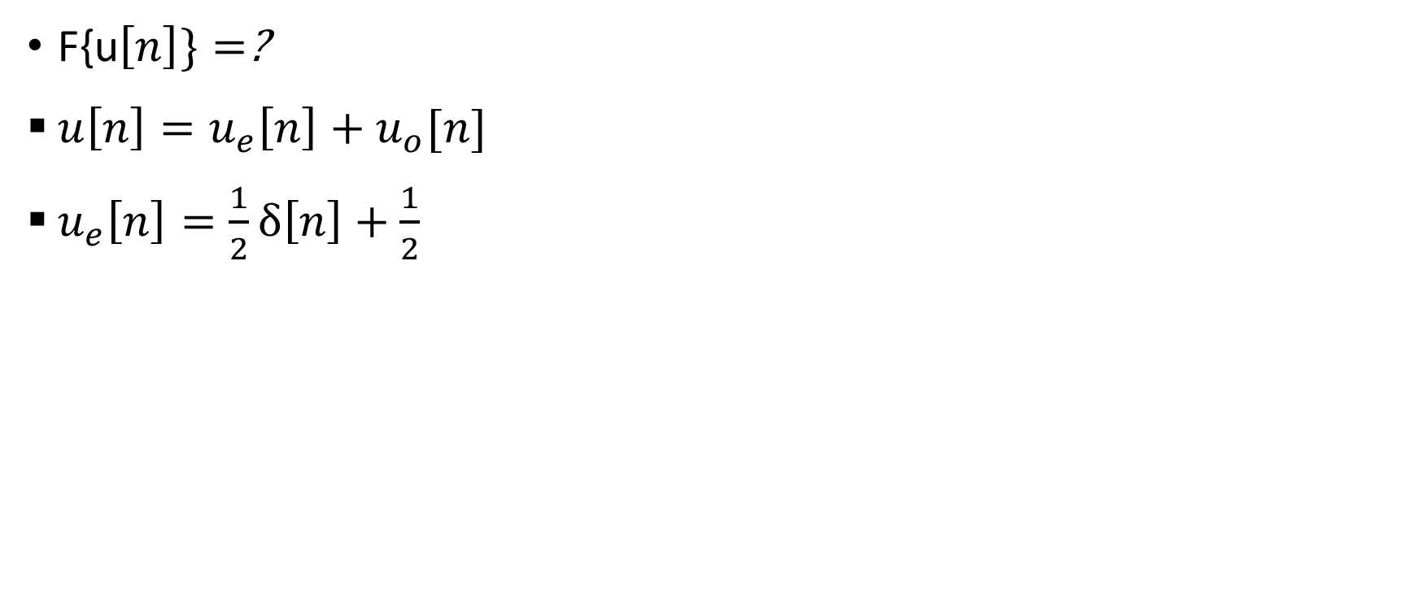
Example
F{u$\left[n\right]\}=$?
$u\left[n\right]=u_{e}\left[n\right]+u_{o}[n]$
$u_{e}\left[n\right]=\frac{1}{2}δ\left[n\right]+\frac{1}{2}$

Slide 11
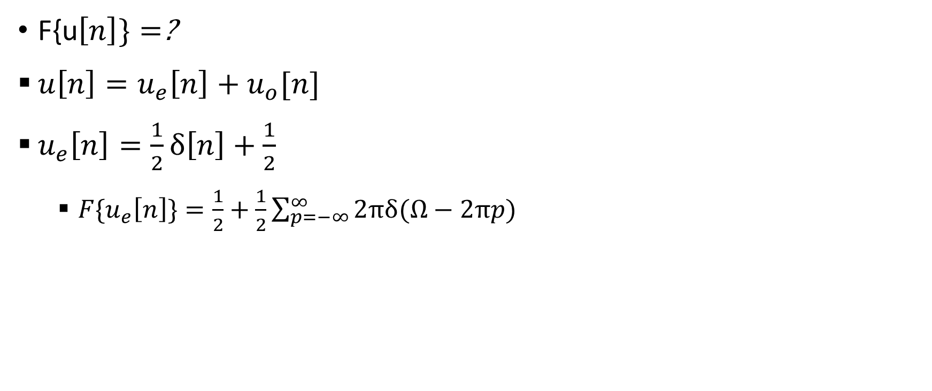
Example
F{u$\left[n\right]\}=$?
$u\left[n\right]=u_{e}\left[n\right]+u_{o}[n]$
$u_{e}\left[n\right]=\frac{1}{2}δ\left[n\right]+\frac{1}{2}$
  ${F\{u}_{e}\left[n\right]\}=\frac{1}{2}+\frac{1}{2}\sum_{p=−∞}^{∞}{2πδ(Ω−2πp)}$

Slide 12
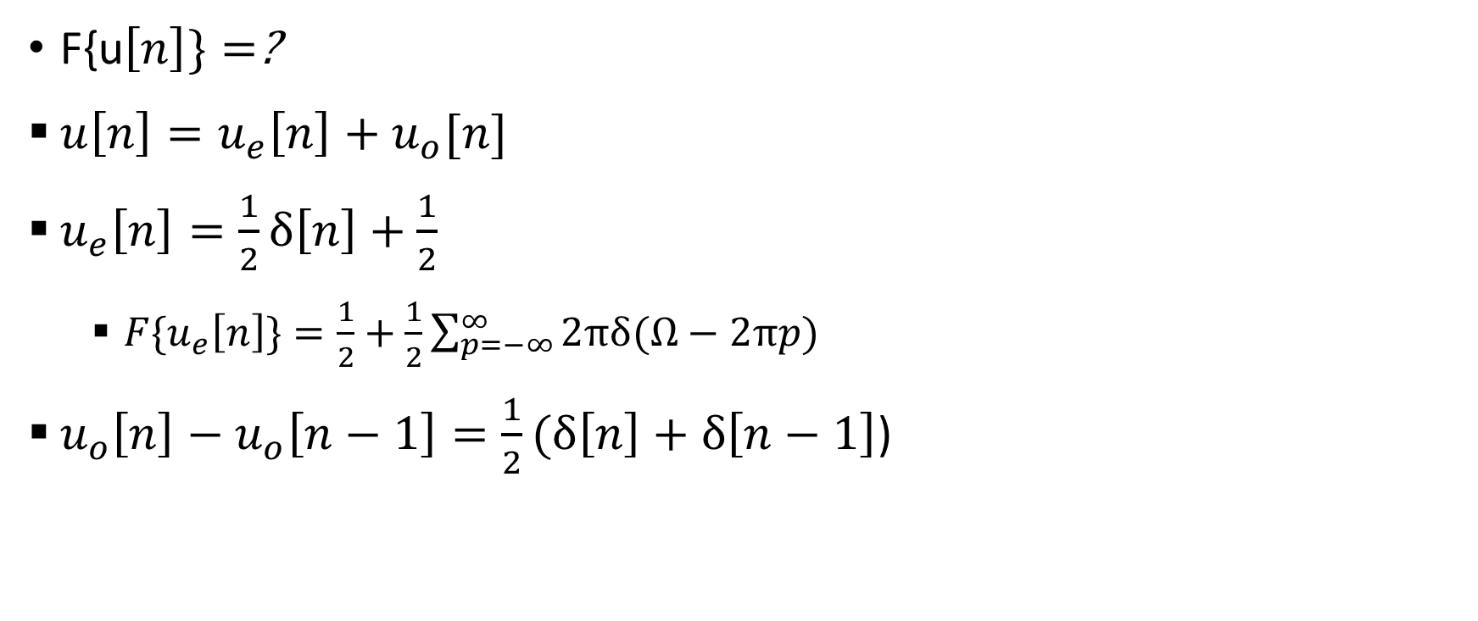
Example
F{u$\left[n\right]\}=$?
$u\left[n\right]=u_{e}\left[n\right]+u_{o}[n]$
$u_{e}\left[n\right]=\frac{1}{2}δ\left[n\right]+\frac{1}{2}$
  ${F\{u}_{e}\left[n\right]\}=\frac{1}{2}+\frac{1}{2}\sum_{p=−∞}^{∞}{2πδ(Ω−2πp)}$
$u_{o}\left[n\right]−u_{o}\left[n−1\right]=\frac{1}{2}(δ\left[n\right]+δ\left[n−1\right]$)

Slide 13
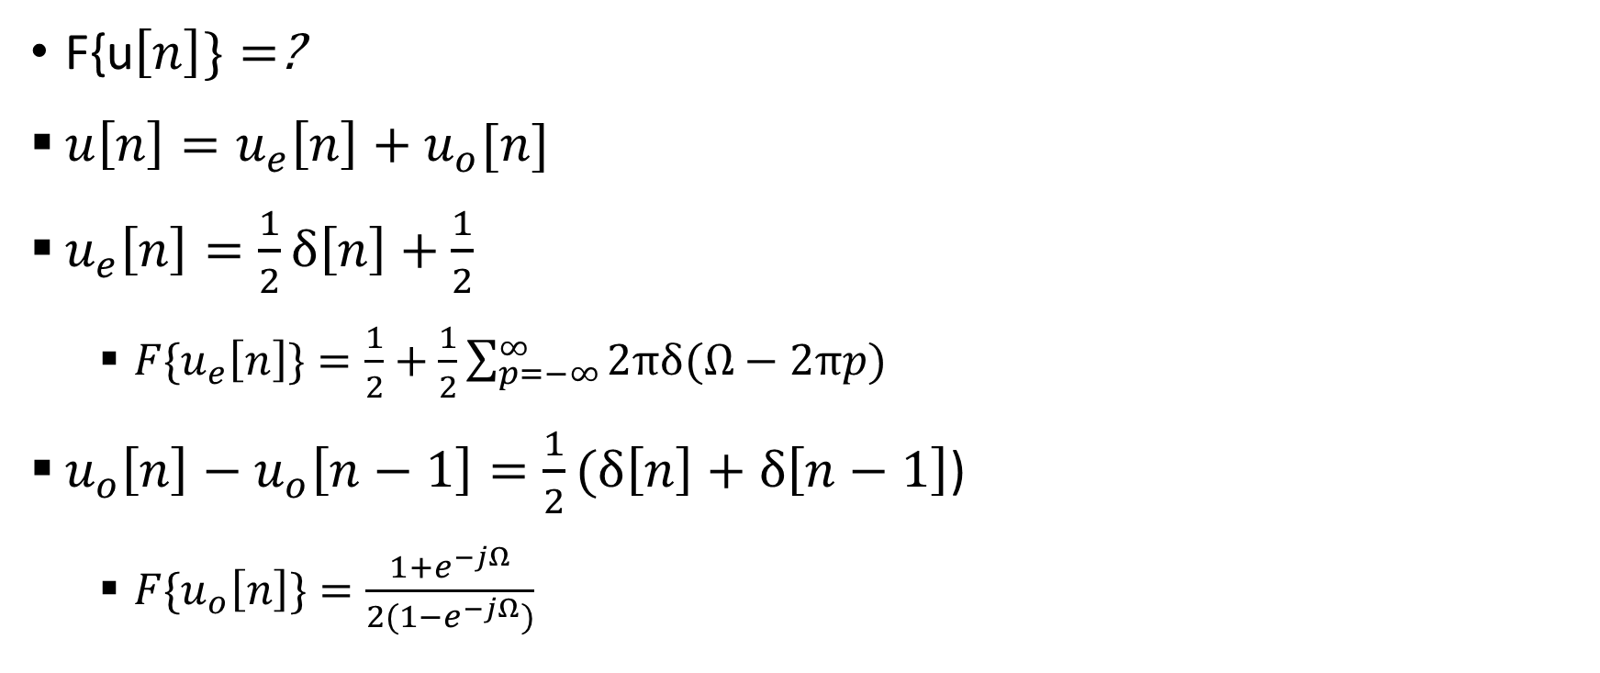
Example
F{u$\left[n\right]\}=$?
$u\left[n\right]=u_{e}\left[n\right]+u_{o}[n]$
$u_{e}\left[n\right]=\frac{1}{2}δ\left[n\right]+\frac{1}{2}$
  ${F\{u}_{e}\left[n\right]\}=\frac{1}{2}+\frac{1}{2}\sum_{p=−∞}^{∞}{2πδ(Ω−2πp)}$
$u_{o}\left[n\right]−u_{o}\left[n−1\right]=\frac{1}{2}(δ\left[n\right]+δ\left[n−1\right]$)
  ${F\{u}_{o}\left[n\right]\}=\frac{1+e^{−jΩ}}{2(1−e^{−jΩ})}$

Slide 14
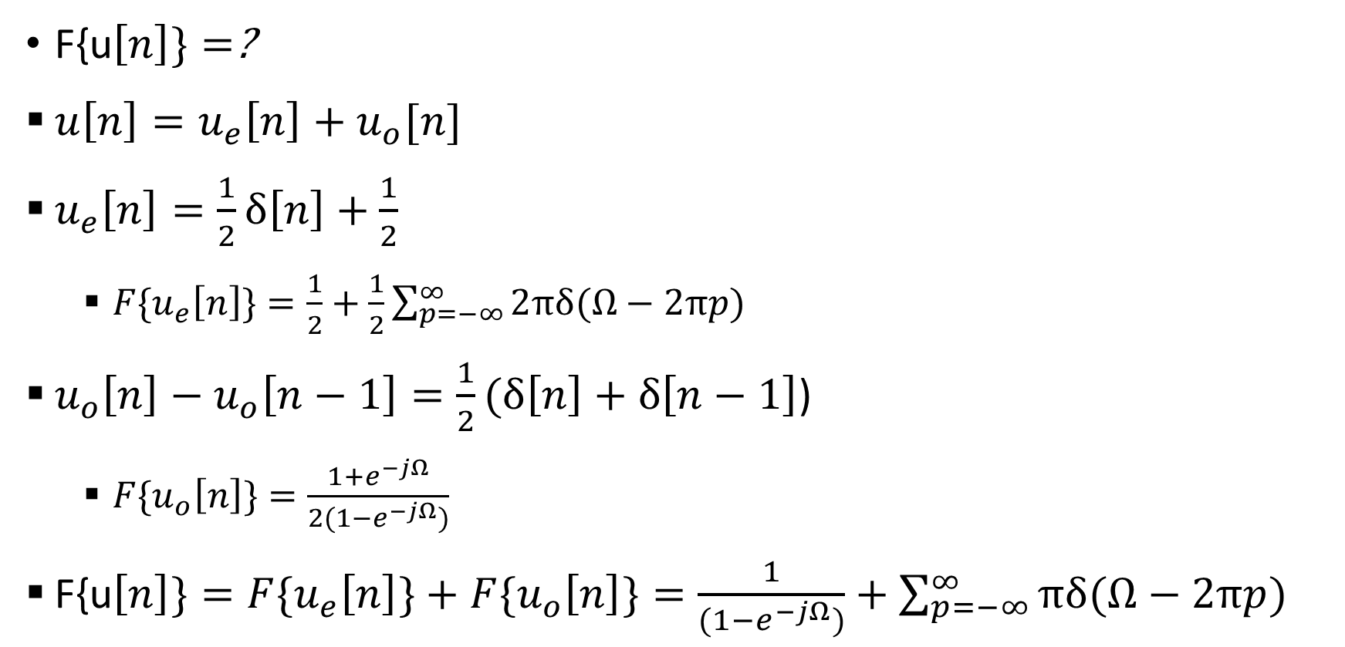
Example
F{u$\left[n\right]\}=$?
$u\left[n\right]=u_{e}\left[n\right]+u_{o}[n]$
$u_{e}\left[n\right]=\frac{1}{2}δ\left[n\right]+\frac{1}{2}$
  ${F\{u}_{e}\left[n\right]\}=\frac{1}{2}+\frac{1}{2}\sum_{p=−∞}^{∞}{2πδ(Ω−2πp)}$
$u_{o}\left[n\right]−u_{o}\left[n−1\right]=\frac{1}{2}(δ\left[n\right]+δ\left[n−1\right]$)
  ${F\{u}_{o}\left[n\right]\}=\frac{1+e^{−jΩ}}{2(1−e^{−jΩ})}$
F{u$\left[n\right]\}={F\{u}_{e}\left[n\right]\}+{F\{u}_{o}\left[n\right]\}=\frac{1}{(1−e^{−jΩ})}+\sum_{p=−∞}^{∞}{πδ(Ω−2πp)}$

Slide 15
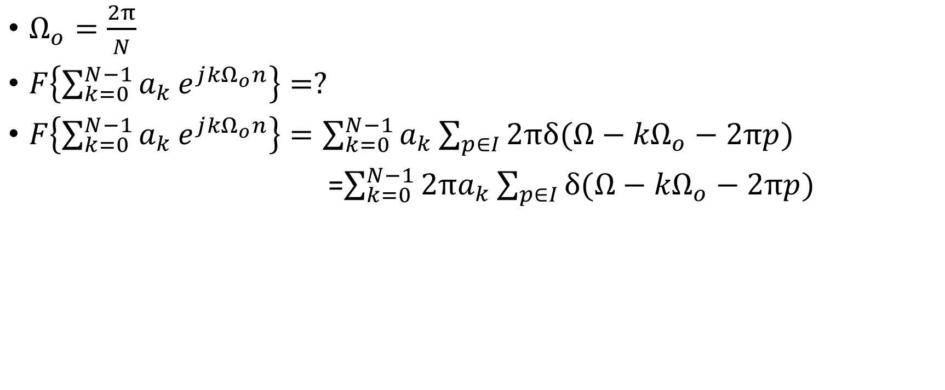
Example
$Ω_{o}=\frac{2π}{N}$
$F\left\{{\sum_{k=0}^{N−1}{a_{k}}e}^{j{kΩ}_{o}n}\right\}=?$
$F\left\{{\sum_{k=0}^{N−1}{a_{k}}e}^{j{kΩ}_{o}n}\right\}=\sum_{k=0}^{N−1}{a_{k}\sum_{p∈I}{2πδ(Ω−{kΩ}_{o}−2πp)}}$
=$\sum_{k=0}^{N−1}{{2πa}_{k}\sum_{p∈I}{δ(Ω−{kΩ}_{o}−2πp)}}$

Slide 16
Example
$F\left\{{\sum_{k=0}^{N−1}{a_{k}}e}^{j{kΩ}_{o}n}\right\}$=$\sum_{k=0}^{N−1}{{2πa}_{k}\sum_{p∈I}{δ(Ω−{kΩ}_{o}−2πp)}}$

Slide 17






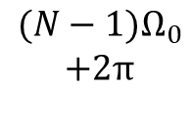




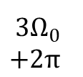







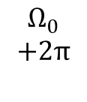


Example
$F\left\{{\sum_{k=0}^{N−1}{a_{k}}e}^{j{kΩ}_{o}n}\right\}$=$\sum_{k=0}^{N−1}{{2πa}_{k}\sum_{p∈I}{δ(Ω−{kΩ}_{o}−2πp)}}$
$$k=$$
$$0$$
$$1$$
$$2$$
$$3$$
$$N−1$$
$$0$$
$$Ω_{0}$$
$${2Ω}_{0}$$
$${3Ω}_{0}$$
$${(N−1)Ω}_{0}$$
$$k=$$
$$N$$
$$N+1$$
$$N+2$$
$$N+3$$
$$2N−1$$
$$2π$$
$$Ω_{0}$$
$$+2π$$
$${2Ω}_{0}$$
$$+2π$$
$$+2π {3Ω}_{0}$$
$${(N−1)Ω}_{0}$$
$$+2π$$

Slide 18
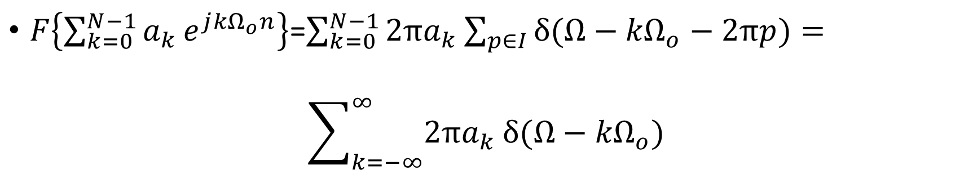
Example
$F\left\{{\sum_{k=0}^{N−1}{a_{k}}e}^{j{kΩ}_{o}n}\right\}$=$\sum_{k=0}^{N−1}{{2πa}_{k}\sum_{p∈I}{δ(Ω−{kΩ}_{o}−2πp)}}=$
$$\sum_{k=−∞}^{∞}{{2πa}_{k}}δ(Ω−{kΩ}_{o})$$

Slide 19
Properties of DTFT
Convolution $x[n]∗h[n]=X(e^{jΩ})$ $Y(e^{jΩ})$

Slide 20
Properties of DTFT
Accumulation $y\left[n\right]=\sum_{m=−∞}^{n}{x[m]→}$

Slide 21
Properties of DTFT
Accumulation $y\left[n\right]=\sum_{m=−∞}^{n}{x[m]→}$
Proof:
$y\left[n\right]=\sum_{m=−∞}^{∞}{x\left[m\right]u\left[n−m\right]=\left(x∗u\right)[n]}$

Slide 22
Properties of DTFT
Accumulation $y\left[n\right]=\sum_{m=−∞}^{n}{x[m]→}$
Proof:
$y\left[n\right]=\sum_{m=−∞}^{∞}{x\left[m\right]u\left[n−m\right]=\left(x∗u\right)[n]}$
$Y(e^{jΩ})=X(e^{jΩ})×\{\frac{1}{\left(1−e^{−jΩ}\right)}+\sum_{p=−∞}^{∞}{πδ(Ω−2πp)\}}$
$Y(e^{jΩ})=\frac{X(e^{jΩ})}{(1−e^{−jΩ})}+\sum_{p=−∞}^{∞}{πX(e^{j0})δ(Ω−2πp)}$

Slide 23
Properties of DTFT
Differentiation in frequency
$$nx\left[n\right]→j\frac{dX(e^{jΩ})}{dΩ}$$

Slide 24
Properties of DTFT
Differentiation in frequency
$$nx\left[n\right]→j\frac{dX(e^{jΩ})}{dΩ}$$
Proof:
$$X\left(e^{jΩ}\right)=\sum_{n}{x\left[n\right]e^{−jΩn}}$$
$$\frac{dX\left(e^{jΩ}\right)}{dΩ}=\sum_{n}{−jnx\left[n\right]e^{−jΩn}}$$

Slide 25
Properties of DTFT
Multiplication
$$x\left[n\right]y[n]→\frac{1}{2π}\int_{2π}{X\left(e^{jθ}\right)}Y\left(e^{j(Ω−θ)}\right)dθ$$

Slide 26
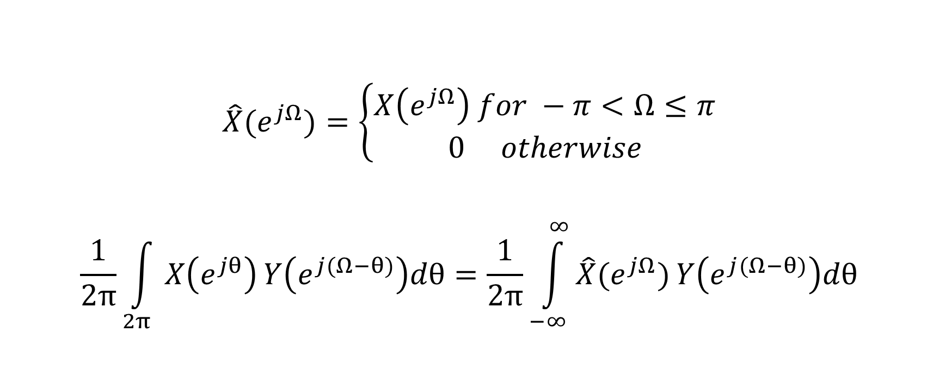
Properties of DTFT
$$\hat{X}(e^{jΩ})=\left\{\begin{aligned}X\left(e^{jΩ}\right) for −π<Ω≤π \\ 0 otherwise\end{aligned}\right.$$
$$\frac{1}{2π}\int_{2π}{X\left(e^{jθ}\right)}Y\left(e^{j(Ω−θ)}\right)dθ=\frac{1}{2π}\int_{−∞}^{∞}{\hat{X}(e^{jΩ})}Y\left(e^{j(Ω−θ)}\right)dθ$$

Slide 27
Properties of DTFT
Multiplication
$$x\left[n\right]y[n]→\frac{1}{2π}\int_{2π}{X\left(e^{jθ}\right)}Y\left(e^{j(Ω−θ)}\right)dθ$$
Mechanics: Aperiodic convolution with one signal as aperiodic

Slide 28


Properties of DTFT
$$0$$
$$2π$$

Slide 29
Properties of DTFT
Parsevals
$$\sum_{n}{x\left[n\right]y\left[n\right]e^{−jΩn}}=\frac{1}{2π}\int_{2π}{X\left(e^{jθ}\right)}Y\left(e^{j(Ω−θ)}\right)dθ$$
$$\sum_{n}{x\left[n\right]\overline{y\left[n\right]}e^{−jΩn}}=\frac{1}{2π}\int_{2π}{X\left(e^{jθ}\right)\overline{Y\left(e^{j(θ−Ω)}\right)}}dθ$$
$$\sum_{n}{x\left[n\right]\overline{y\left[n\right]}}=\frac{1}{2π}\int_{2π}{X\left(e^{jθ}\right)\overline{Y\left(e^{j(θ)}\right)}}dθ$$

Slide 30
Properties of DTFT
Parsevals
$$\sum_{n}{x\left[n\right]\overline{y\left[n\right]}}=\frac{1}{2π}\int_{2π}{X\left(e^{jθ}\right)\overline{Y\left(e^{j(θ)}\right)}}dθ$$
$$\sum_{n}{x\left[n\right]\overline{x\left[n\right]}}=\frac{1}{2π}\int_{2π}{X\left(e^{jθ}\right)\overline{X\left(e^{j(θ)}\right)}}dθ$$

Slide 31
Properties of DTFT
Duality between CTFS and DTFT

Slide 32
Properties of DTFT
Duality between CTFS and DTFT
$$a_{k}=\frac{1}{T}\int_{T}{x\left(t\right)e^{−jk\frac{2π}{T}t}dt}$$

Slide 33
Properties of DTFT
Duality between CTFS and DTFT
$$a_{k}=\frac{1}{T}\int_{T}{x\left(t\right)e^{−jk\frac{2π}{T}t}dt}$$
$$a_{k}=\frac{1}{2π}\int_{2π}{x\left(t\right)e^{−jk\frac{2π}{2π}t}dt}$$

Slide 34
Properties of DTFT
Duality between CTFS and DTFT
$$a_{k}=\frac{1}{T}\int_{T}{x\left(t\right)e^{−jk\frac{2π}{T}t}dt}$$
$$a_{k}=\frac{1}{2π}\int_{2π}{x\left(t\right)e^{−jk\frac{2π}{2π}t}dt}$$
$$a_{k}=\frac{1}{2π}\int_{2π}{x\left(t\right)e^{−jkt}dt}$$
$$t→Ω$$
$$a_{k}=\frac{1}{2π}\int_{2π}{x\left(Ω\right)e^{−jkΩ}dΩ}$$

Slide 35
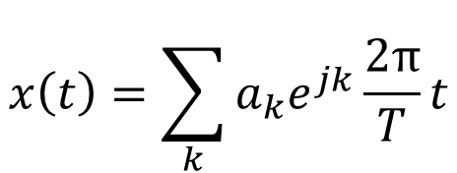
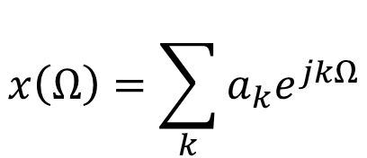
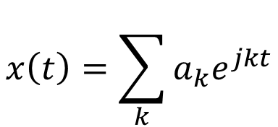
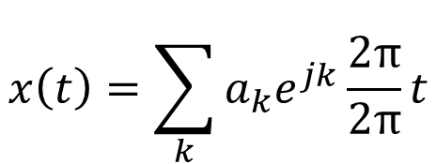
Properties of DTFT
Duality between CTFS and DTFT
$$a_{k}=\frac{1}{T}\int_{T}{x\left(t\right)e^{−jk\frac{2π}{T}t}dt}$$
$$x\left(t\right)=\sum_{k}{a_{k}e^{jk}\frac{2π}{T}t}$$
$$a_{k}=\frac{1}{2π}\int_{2π}{x\left(t\right)e^{−jk\frac{2π}{2π}t}dt}$$
$$x\left(t\right)=\sum_{k}{a_{k}e^{jk}\frac{2π}{2π}t}$$
$$a_{k}=\frac{1}{2π}\int_{2π}{x\left(t\right)e^{−jkt}dt}$$
$$x\left(t\right)=\sum_{k}{a_{k}e^{jkt}}$$
$$t→Ω$$
$$x\left(Ω\right)=\sum_{k}{a_{k}e^{jkΩ}}$$
$$a_{k}=\frac{1}{2π}\int_{2π}{x\left(Ω\right)e^{−jkΩ}dΩ}$$

